Slide 1

Healthcare Service Analysis Report

Slide 2
Introduction
This report provides an analysis of a healthcare service dataset, focusing on
patient demographics,
resource utilization,
key operational challenges,
It also includes recommendations for improving hospital operations, resource utilization, and patient care outcomes.

Slide 3
Background of the Identified Healthcare Service
Advantages:
Comprehensive Patient Data: The dataset includes detailed patient demographics (age, gender, blood type), medical history, billing, and treatment information, which can be used to improve personalized care.
Revenue Generation: Revenue data from medications and consultations helps assess financial performance and allocate resources more effectively.

Slide 4
Diverse Admission Types: Different types of admissions (e.g., Urgent, Emergency, Elective) allow us to see how patient needs vary, enabling tailored strategies for resource management.
Insurance Coverage: Information on insurance providers can aid in assessing payment trends, understanding financial class impact, and developing plans to manage uncompensated care.

Slide 5
Disadvantages:
High Costs: Some patients incur significant billing amounts, particularly in urgent or emergency cases, which could strain hospital finances if costs aren’t managed.
Complexity in Resource Allocation: The diverse needs (e.g., cancer, obesity, diabetes) and varied admission types may require flexible resource allocation, which can be challenging to manage efficiently.
Inconsistent Patient Outcomes: Variability in test results (Normal, Abnormal, Inconclusive) highlights differences in treatment effectiveness, suggesting that outcome predictability is limited.

Slide 6
Problems Faced (Health Informatics Context)
Service Delays and Wait Times: Variance in “Entry Time,” “Post-Consultation Time,” and “Completion Time” could lead to patient dissatisfaction, especially in urgent or emergency cases.
High Medication and Lab Costs: Lab and medication costs might not always align with patient outcomes, highlighting potential inefficiencies.
Inefficient Resource Usage: In cases where specialized doctors or specific rooms are overbooked, it can lead to delays and strain on certain resources.
Financial Disparities: Patients with different financial classes and insurance providers might have different access to services, which could affect equity in care delivery.

Slide 7
Patient Demographics and Overview
• Total Patients: 40.24K
• Gender Distribution: Male (49.9%), Female (50.1%)
• Blood Types and Medical Conditions: Overview of common conditions such as arthritis, diabetes, and hypertension.
• Admission Types: Breakdown of admissions - Elective, Urgent, Emergency.

Slide 8
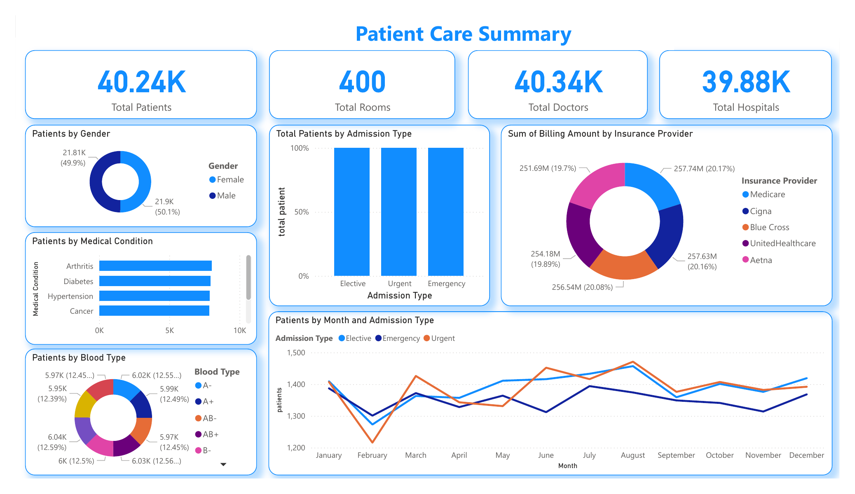
Overview & Patient Care Summary

Slide 9
Resource Utilization
• Doctor and Room Allocations: High patient loads on specific doctors (e.g., Dr. Michael Smith).
• Total Rooms and Distribution: Insights into room availability across months and conditions.
• Doctor Types: Dependence on specific doctor roles (e.g., ANCHOR doctors handling a majority of cases).

Slide 10
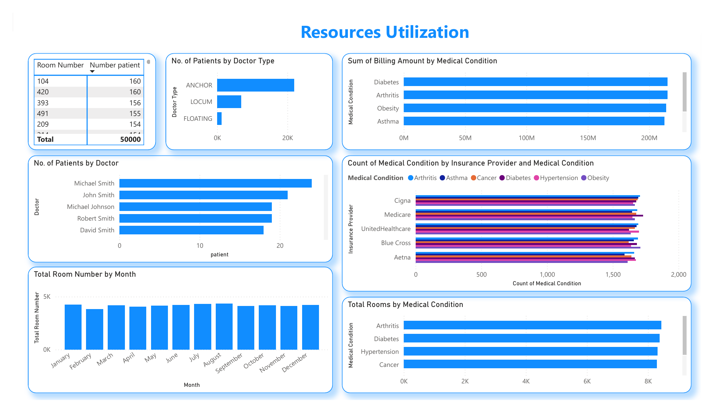
Data Visualization - Page 3

Slide 11
Test Results and Treatment Outcomes
• Test Results Summary: Distribution of normal, abnormal, and inconclusive results.
• Key Medical Conditions: Test results for conditions such as asthma, cancer, and diabetes.
• Consultation Revenue: Analysis by doctor type (ANCHOR, LOCUM, FLOATING).

Slide 12
Financial Performance
• Revenue Sources: Consultation, medication, and insurance contributions.
• Insurance Providers: Major providers include Medicare, Blue Cross, Cigna, UnitedHealthcare, Aetna.
• Billing and Financial Trends: Analysis of billing amounts by insurance provider.

Slide 13
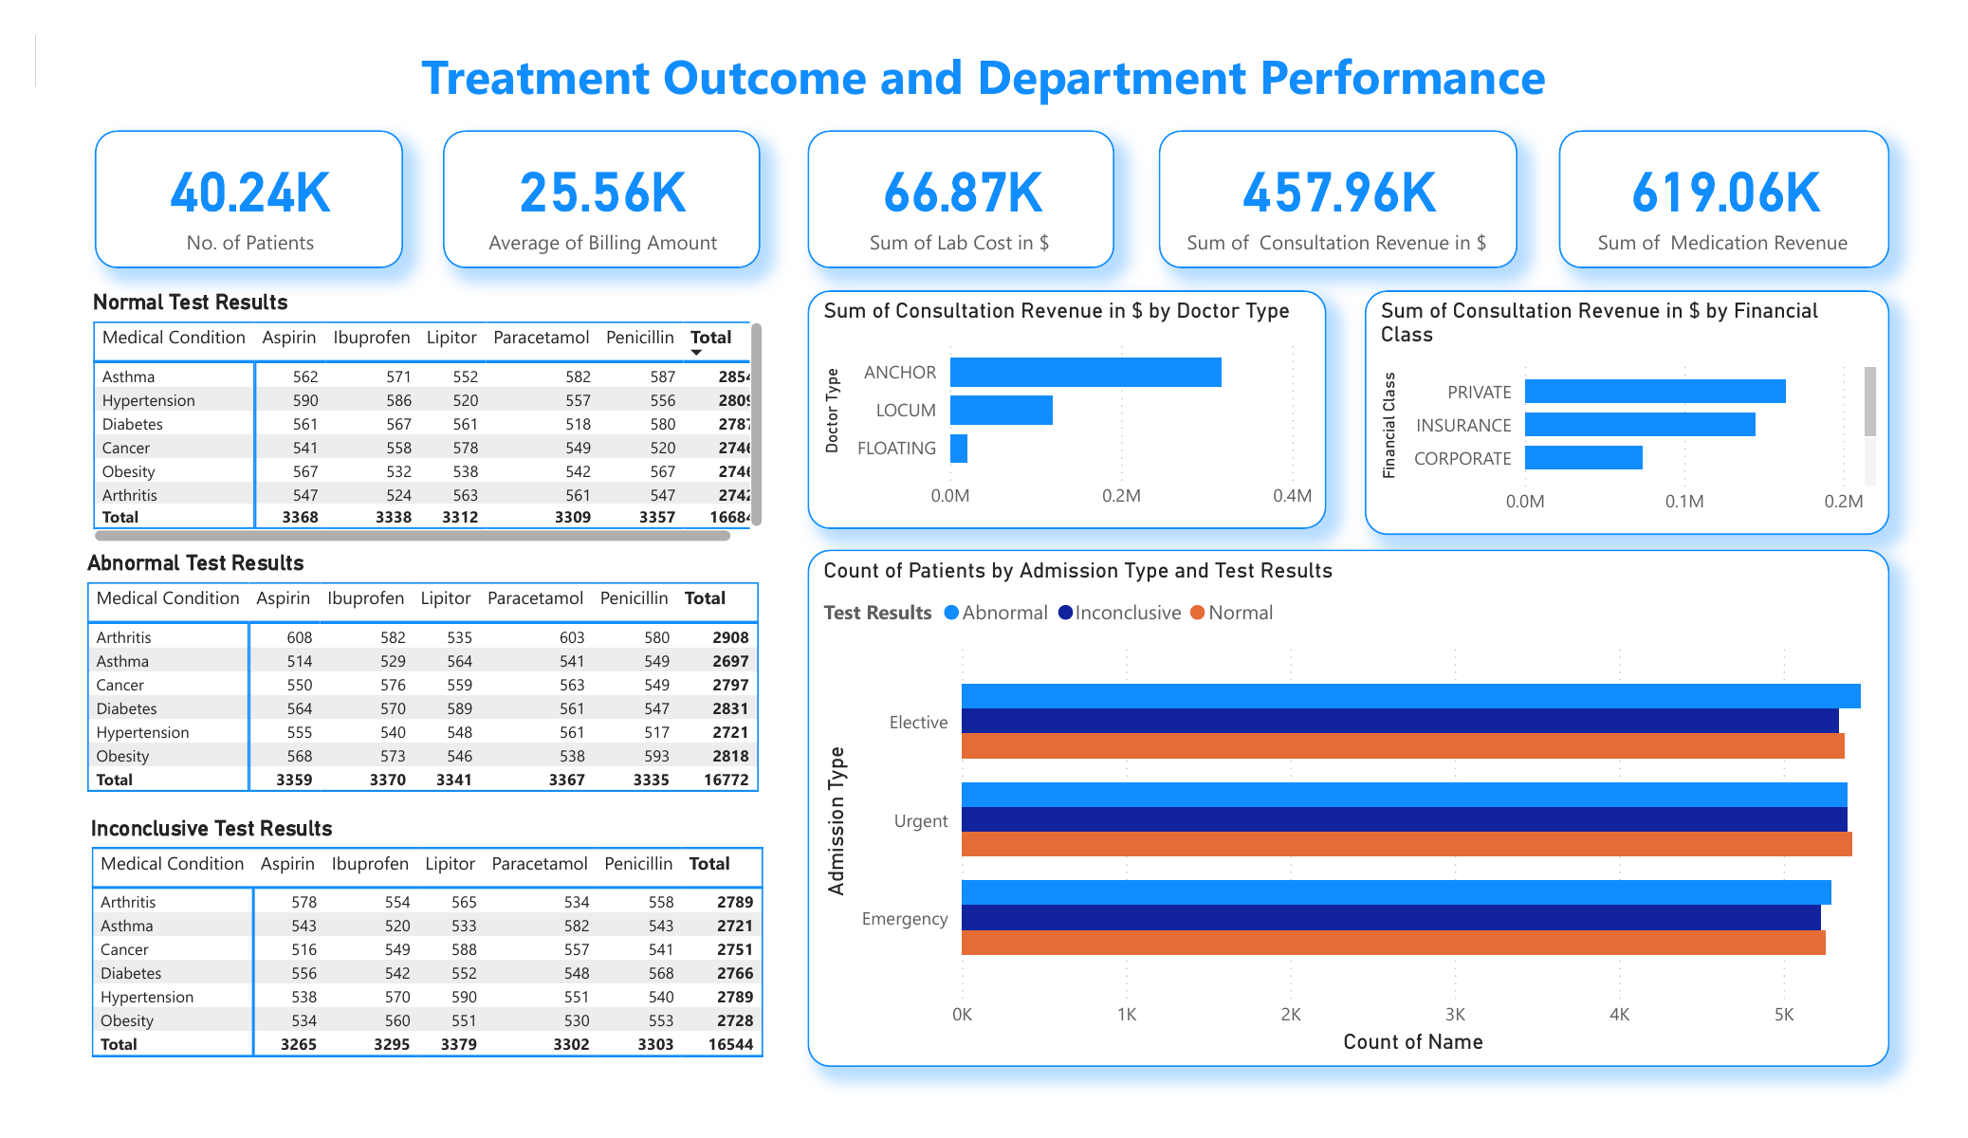
Treatment Outcomes and Department Performance

Slide 14
Healthcare Challenges
• Service Delays and Wait Times: Potential dissatisfaction in emergency and urgent cases.
• Resource Allocation: Challenges in managing resources effectively for various admission types.
• Financial Disparities: Differences in service access by insurance coverage and financial class.

Slide 15
Recommendations
1. Enhance resource allocation for high-demand periods.
2. Strengthen emergency care protocols.
3. Focus on chronic conditions like arthritis and asthma.
4. Optimize billing for Medicare patients.
5. Redistribute patient loads among doctors to avoid burnout.

Slide 16
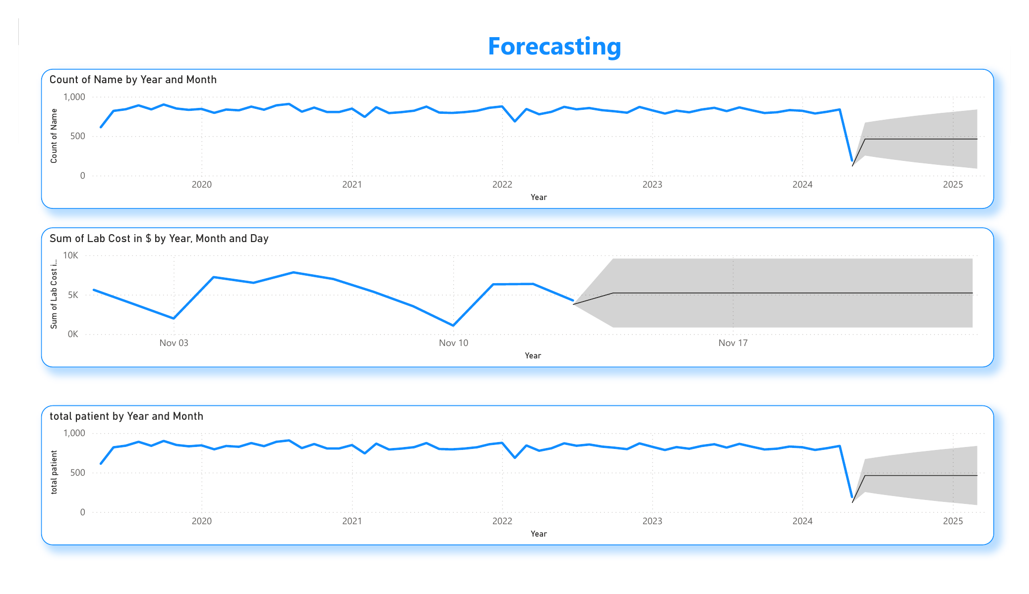
Forecasting

Slide 17
THANK YOU

